Slide 1
Image Enhancement in frequency domain
Image enhancement can be done by applying filers a real mage
Here filers is used to smoothen and sharping of image by removing very high and low frequency component .
This change taken place a whole image unlike enhancement in special domain .
So we will have two filter.
Low pass filters.
High pass filters.

Slide 2
Low Pass filter
It removes all high frequency component from the image and only keeps low frequency component of image
This filter mainly used to smoothen the image /blurring the image
This is used to remove the noise from the image .
High Pass Filter
It remove all low frequency component from the image and only keeps .high frequency component of image .
This filter mainly use to sharpen the image .
This types of image will not have background .

Slide 3
Some types of low pass and high pass filter are as follow
Low pass filter
Ideal low pass
Butterworth low pass
Gaussian law pass
High pass filter
Ideal high pass
Butterworth low pass
Gaussian law pass

Slide 4
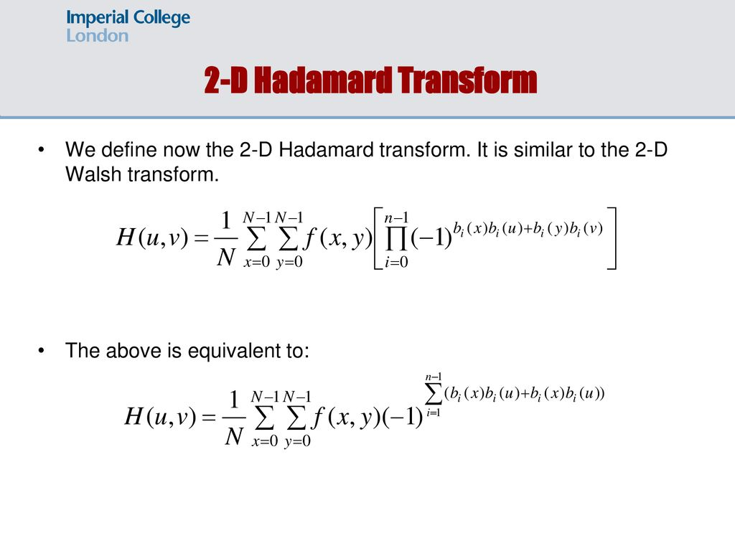
2D Hadamard Transformation .
It is similar to the 2D walsh transform
2D Hadamard transform is given gy:

Slide 5
Hadamard Transform(HT)
HT is basically the same as Walsh transform except the rows of the transform matrix are reordered .
The element of mutually orthogonal basis vector of a HT are either +1 and -1.
It result in vary low computational complexity in the calculation of the transform coefficient.

Slide 6
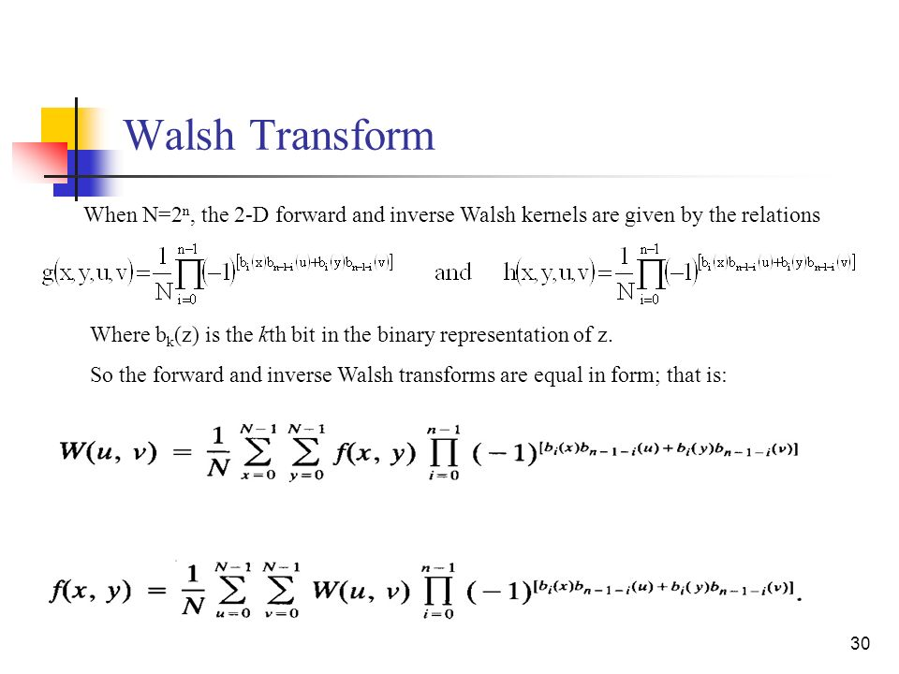

Slide 7
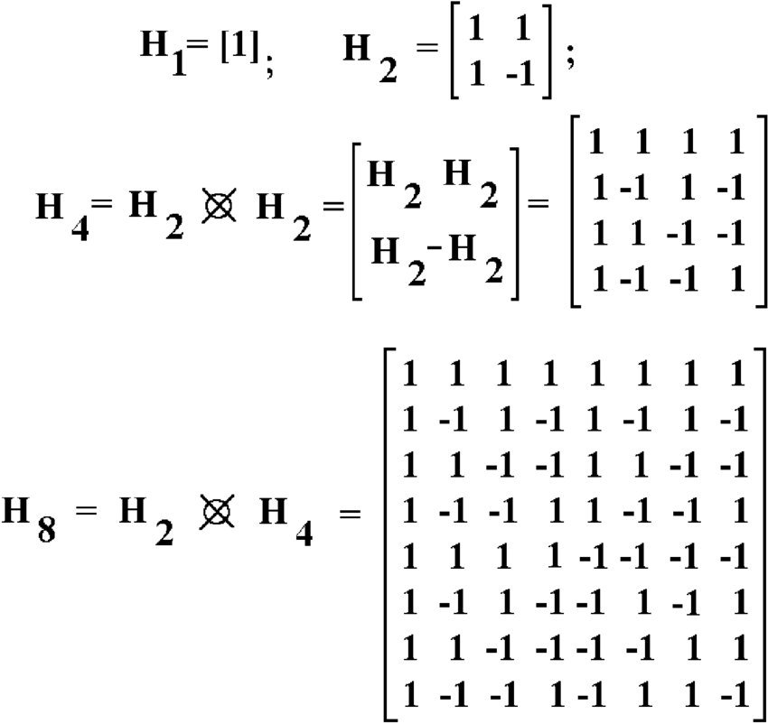

Slide 8
Haar Transform
Haar Transform is computational efficient transform as the transform required for N-point vector only 2(n-1) addition and N multiplication element of orthogonal matrix are either 1,0,-1 multiplied by power of √2

Slide 9
Algorithm to generate Haar Basis
Step1:- Determine the order N of the haar basis.
Step2:-Determine n where n=log2N.
Step3:- Determine P&Q.
0 ≤P ≤n-1
If P=0 then q=0 or q=1
If p ≠then 1 ≤q ≤2
Step4 :-Determine k k=2^p+q-1
Step 5:-Determine Z
Z=[0,1]={0/N ,1/N,……..,N-1/N}
Step6:-If K=0 then H(z)=i/root N
Other wise.
Flow chart.

Slide 10
Properties:-
Haar transform is always real and orthogonal.
It is very fast transform.
It has poor energy compaction for image.
Disadvantage:-
Very poor energy compaction for image.
Reconstruction error is higher.
Advantage:-
It is very fast transform used in feature extraction and image coding .
It is used for data compression problem.

